Slide 1
Practice Quiz- Measurement Skills

Slide 2
1. A student uses a spring scale to measure the weight of an object. The student mistakenly adjusts the zero position of the scale at the 1.0 N mark instead of the 0.0 N mark. All subsequent weights he measures are too small by 1.0 N. This type of error is an example of:
Random Error
Systematic Error
Explain your reasoning:

Slide 3
2. A group three students make repeated measurements of the length of a steel bar. Their measurements are below: 7.7 cm, 7.6 cm, 7.5 cm
Determine their average measurement. Use the range of values to determine the uncertainty.: _____________
According to the manufacturer, the bar is actually 8.2 cm long. How would you describe their set of measurements?
Accurate but not precise
Precise but not accurate
Precise and accurate
Neither precise nor accurate
Explain your reasoning:

Slide 4
3. How many significant digits are there in the following measurements?
1.005 m ___________
550 km ____________
25.50 s ____________
20 cycles of a pendulum _________
1.3450 L ____________
8.050 x 10² g ____________

Slide 5
4. Complete the statements regarding the “weakest link rules” using the terms below:
number with the lowest precision (fewest decimal places)
number with the least number of significant digits
1. When multiplying or dividing measurements the ____________________________ is the weakest link.
2. When adding or subtracting measurements the ____________________________ is the weakest link.

Slide 6
5. When finding the volume of a box, a student multiplies the box dimensions below:
5.0 cm x 15.0 cm x 85.0 cm
How should they record their answer?
6.4 x 10 ³ cm ³
6.375 x 10 ³ cm ³
6.37 x 10 ³ cm ³
6.38 x 10 ³ cm ³
Explain your reasoning:

Slide 7
6. When finding the perimeter of a yard, a student adds the following length measurements:
10.0 m + 25.0 m + 1.2 x 10 ² m
How should they record their answer?
1.550 x 10 ² m
1.50 x 10 ² m
1.55 x 10 ² m
1.6 x 10 ² m
Explain your reasoning:

Slide 8
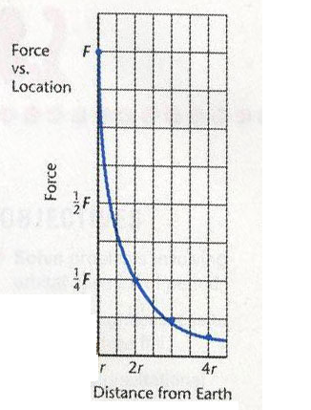
7. The graph below shows a plot of force of gravity versus distance from the Earth’s centre. What type of relationship is shown?
A. linear
B. power
C. inverse
D. root

Slide 9
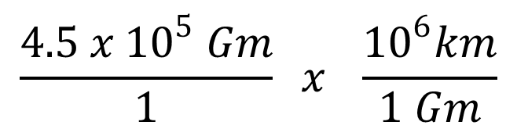
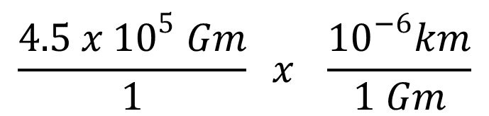
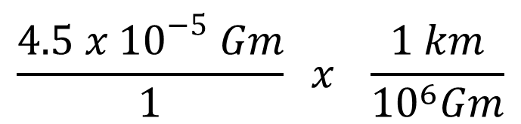
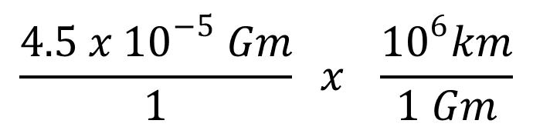
8. Which of the following is the correct statement for completing the following conversion?:
0.000045 Gm = ? kM
A.
$$\frac{4.5 x {10}^{5} Gm}{1} x \frac{{10}^{6}km}{1 Gm}$$
B.
$$\frac{4.5 x {10}^{−5} Gm}{1} x \frac{1 km}{{10}^{6}Gm}$$
C.
$$\frac{4.5 x {10}^{5} Gm}{1} x \frac{{10}^{−6}km}{1 Gm}$$
$$\frac{4.5 x {10}^{−5} Gm}{1} x \frac{{10}^{6}km}{1 Gm}$$
D.

Slide 10
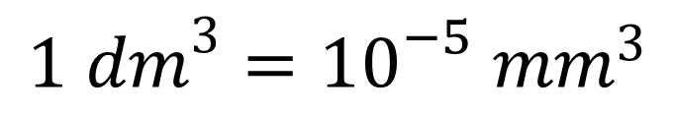
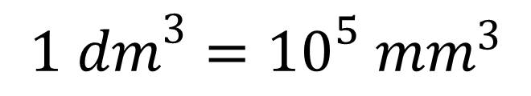
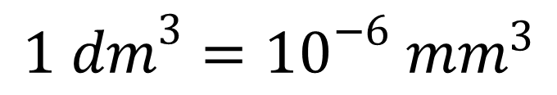
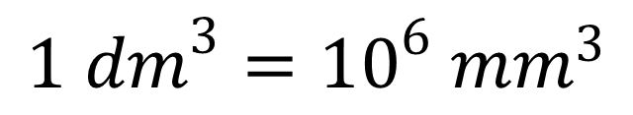
9. Which of the following is the correct conversion factor for completing the following conversion?
180 000 mm³ = ? dm³
A.
$$1 {dm}^{3}={10}^{6} {mm}^{3}$$
B.
$$1 {dm}^{3}={10}^{−6} {mm}^{3}$$
C.
$$1 {dm}^{3}={10}^{5} {mm}^{3}$$
D.
$$1 {dm}^{3}={10}^{−5} {mm}^{3}$$

Slide 11
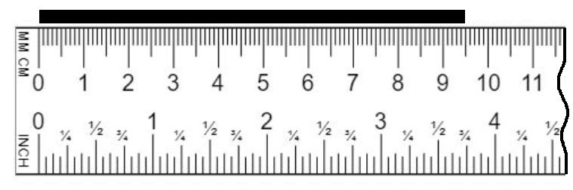
Record your measurement of the black line shown below using the given ruler.
Include your estimated uncertainty.
Measurement: __________________________________
Explain your reasoning:

Slide 12
12. Complete the following conversions. Show your work!
a) 154,000 Gg = ? Kg b) 65.0 km/h = ? m/s

